Slide 1
Establishing Resources
Microsoft Project 2016
Lesson 2

Slide 2
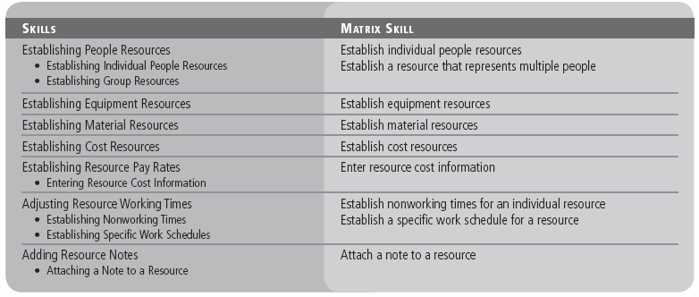
Objectives

Slide 3
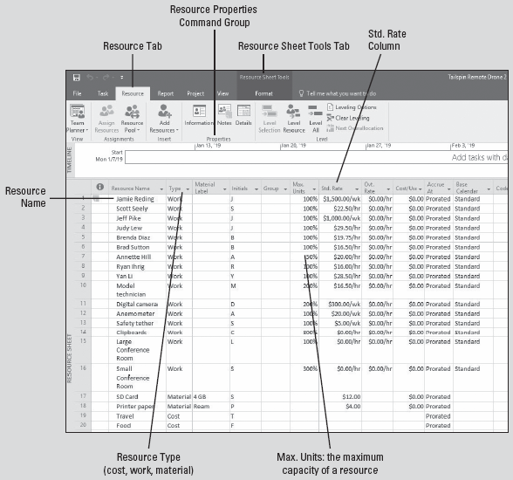
Software Orientation
Several views are available in Microsoft Project, including the Resource Sheet view, shown here.
Project resources are the people, equipment, materials, and money used to complete the tasks in a project.
Notes:
Your screen might be different if default settings have been changed or if other preferences have been set.

Slide 4
Establishing People Resources
When you set up people resources in Microsoft Project, you are able to track who is available to work, the type of work they can do, and when they are available to do it.
People resources can be in the form of individuals, individuals identified by their job function or title, or groups of individuals with a common skill.
When entering people resource information, keep in mind two important aspects of these resources: availability and cost.
Availability determines when and how much of a resource’s time can be assigned to work on tasks.
Cost refers to how much money will be needed to pay for the resources on a project.

Slide 5
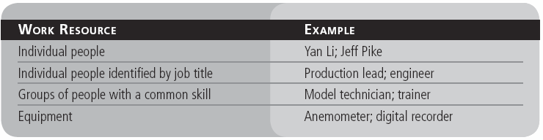
Establishing People Resources
You will use three types of resources in Microsoft Project: work resources, material resources, and cost resources.
Work resources are the people and equipment that do work to accomplish the tasks of the project. Work resources use time to accomplish tasks.
Work resources can be in many different forms:
Notes:
You will learn about material resources and cost resources later in this lesson.

Slide 6
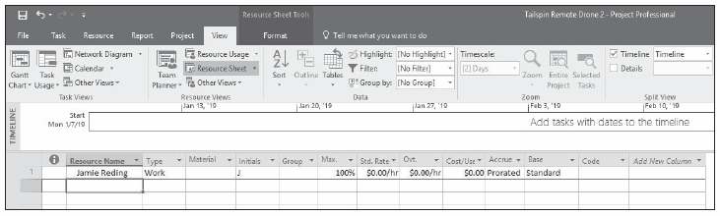
Step-by-Step: Establish Individual People Resources
GET READY. Before you begin these steps, open Tailspin Remote Drone 2M from the data files for this lesson.
Click the View tab. In the Resource Views group, select Resource Sheet to open the Resource Sheet view.
In the Resource Sheet view, click the empty cell directly below the Resource Name column heading.
Key Jamie Reding and press Enter. Microsoft Project adds Jamie Reding as a work resource and automatically enters default information. Your screen should look similar to the figure below.
Notes:
Take Note: If your resource information for your own project exists on your network, such as in a Microsoft Outlook address book, you can quickly import the resource information into Microsoft Project. This saves the time and effort of retyping the information and reduces the possibility of data entry errors.

Slide 7
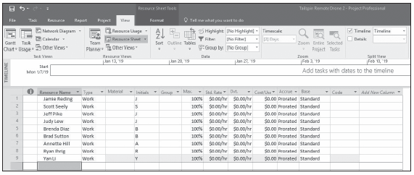
Step-by-Step: Establish Individual People Resources
Enter the remaining resource names into the Resource Sheet:
Scott Seely Brenda Diaz Ryan Ihrig
Jeff Pike Brad Sutton Yan Li
Judy Lew Annette Hill
SAVE the file as Tailspin Remote Drone 2.
PAUSE. LEAVE Microsoft Project open for the next exercise.
Notes:
Resource Sheet with resources added

Slide 8
Step-by-Step: Establish a Resource That Represents Multiple People
GET READY. USE the Tailspin Remote Drone 2 project schedule you saved in the previous exercise.
Click the blank Resource Name field below the last resource, key Model technician, and then press Tab.
In the Type field, make sure that Work is selected. Press Tab four times to move to the Max. Units field.
You might only see a portion of the field name. To see the entire field name, place the cursor on the bottom of the header row in the ID column (just above resource 1) and click and drag the row down.
In the next step, you will configure maximum units. Maximum units refers to the maximum capacity of a resource to accomplish tasks. The default value for maximum units is 100%.
Notes:
In the previous exercise, you set up resources that were individuals. In this exercise, you will set up a single resource that represents multiple people, sometimes called a generic resource.

Slide 9
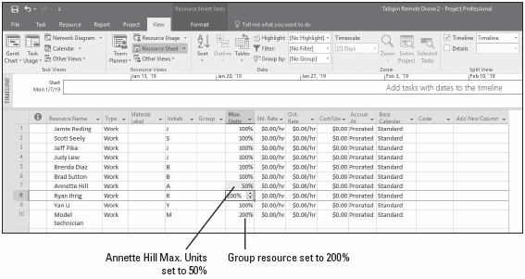
Step-by-Step: Establish a Resource That Represents Multiple People
In the Max. Units field for the Model technician, key or select 200% to indicate that you will have two model technicians devoting 100% of their working time to this project, and then press Enter.
Click the Max. Units field for Annette Hill, key or select 50%, and press Enter. Your screen should look similar to the figure below.
SAVE the project schedule.
PAUSE. LEAVE the project schedule open for the next exercise.
Notes:
Take Note: You can also enter maximum units as a decimal rather than a percentage. To change to this format, on the ribbon, click File, then Options, and then click the Schedule option. In the Show assignment units as a box, select Decimal.

Slide 10
Establishing Equipment Resources
Setting up equipment resources is very similar to setting up people resources. There are key differences, however, in the way equipment resources can be scheduled.
Equipment resources tend to be more specialized than people resources. For example, a clipboard can’t be used as a digital camera, but a model technician might be able to fill in as someone who may ask survey questions.
Some equipment resources might work 24 hours a day, but most people resources work only 8 or 10 hours a day.
It is helpful to track equipment resources when you need to schedule and track equipment costs, or when the equipment might be needed by multiple people at the same time.

Slide 11
Step-by-Step: Establish Equipment Resources
GET READY. USE the Tailspin Remote Drone 2 project schedule you saved in the previous exercise.
In the Resource Sheet, click the next empty cell in the Resource Name column.
Click the Resource tab. In the Properties group, click the Information button.
If it is not already displayed, click the General tab in the Resource Information dialog box.
In the Resource Name field, key Digital camera and then press Enter.
In the Type field, select Work from the drop‐down menu. Your screen should look similar to the figure shown on the next slide.
Notes:
Another Way: In Step 2, you can also activate the Resource Information dialog box by double‐clicking a resource name or an empty cell in the Resource Name column.

Slide 12
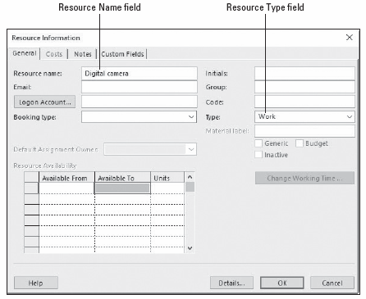
Step-by-Step: Establish Equipment Resources
Click OK. The Resource Information dialog box closes and the resource has been added. Notice that Microsoft Project has automatically wrapped the text in the Resource Name field, and the Max. Units field is set to the default of 100%.
Notes:
Resource Information dialog box with newly added resource

Slide 13
Step-by-Step: Establish Equipment Resources
In the Max. Units field for the digital camera, key 200, and then press Enter. This indicates that you will have two digital cameras available every workday.
Add the following additional equipment resources to the project schedule. Enter the information directly in Resource Sheet view. Select Work in the Type field for each resource.
Resource Name Max. Units
Anemometer 100%
Safety tether 100%
Clipboards 800%
Large Conference Room 100%
Small Conference Room 300%
Your screen should look like the figure on the next slide.

Slide 14
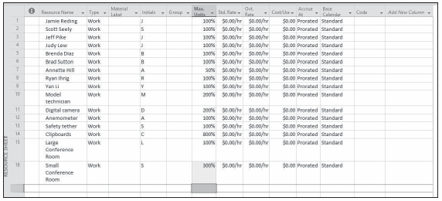
Step-by-Step: Establish Equipment Resources
SAVE the project schedule.
PAUSE. LEAVE the project schedule open for the next exercise.
Notes:
Resource Sheet showing equipment resources added

Slide 15
Establishing Material Resources
Just as you established people and equipment resources in your project schedule, you can also set up material resources in Microsoft Project to track the rate of use of the particular resource and its related cost.
Material resources are consumable items used up as the tasks in a project are completed.
Unlike work resources, material resources have no effect on the total amount of work scheduled to be performed on a task.
For the remote drone project, SD cards for the digital camera and paper are the consumable items that interest you the most.
Notes:
Depending on the depth of your planning, Microsoft Project can provide an accurate Bill of Material (BOM) for your project’s material resources.

Slide 16
Step-by-Step: Establish Material Resources
GET READY. USE the Tailspin Remote Drone 2 project schedule you saved in the previous exercise.
In the Resource Sheet, click the next empty cell in the Resource Name column.
Key SD card and press Tab.
In the Type field, click the arrow, select Material, and then press Tab.
In the Material Label field, key 4 GB and press Enter. This means you will use 4 gigabytes as the unit of measure to track consumption during the project.
Click the next empty cell in the Resource Name column.
Key Printer paper and press Tab.
Notes:
Notice that some of the fields (columns), such as Max. Units, Ovt. Rate, and Calendar, are not available when you change to a material type resource.

Slide 17
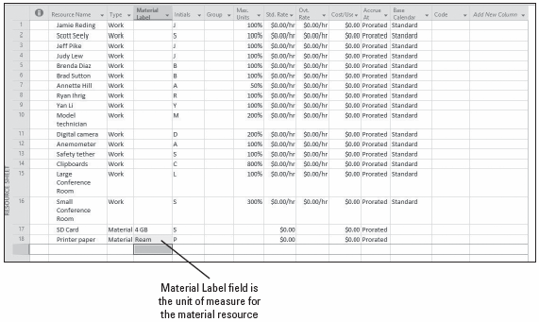
Step-by-Step: Establish Material Resources
In the Type field, click the arrow, select Material, and press Tab.
In the Material Label field, key Ream and press Enter. Your screen should look similar to the figure below.
SAVE the project schedule.
PAUSE. LEAVE the project schedule open for the next exercise.
Notes:
Material resources added to Resource Sheet

Slide 18
Establishing Cost Resources
Cost resources are financial obligations to your project. A cost resource enables you to apply a cost to a task by assigning a cost item (such as travel) to that task.
The cost resource has no relationship to the work assigned to the task, but assigning cost resources gives you more control when applying types of costs to tasks within your project.
A cost resource is a resource that doesn’t depend on the amount of work on a task or the duration of a task. Unlike fixed costs, you can apply as many cost resources to a task as necessary.
In the following exercise, you will add cost resources to the Resource Sheet for your project.

Slide 19
Step-by-Step: Establish Cost Resources
GET READY. USE the Tailspin Remote Drone 2 project schedule you saved in the previous exercise.
In the Resource Sheet, click the next empty cell in the Resource Name column.
Key Travel and press Tab.
In the Type field, click on the arrow and select Cost. The travel resource has now been established as a cost resource. Just as with a material resource, some fields are not available with a cost resource.
In the blank Resource Name field below Travel, key Food and press Tab.
Notes:
Take Note: Cost resources differ from fixed costs in that cost resources are created as a type of resource and then assigned to a task. Also, unlike work resources, cost resources cannot have a calendar applied to them and therefore do not affect the scheduling of the task. The dollar value of cost resources doesn’t depend on the amount of work done on the task to which they are assigned.

Slide 20
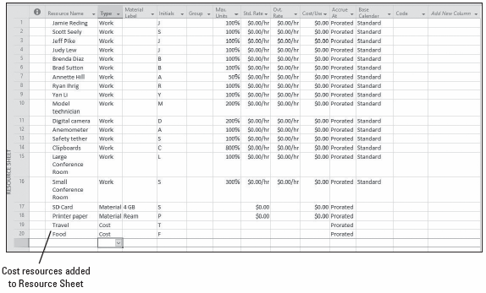
Step-by-Step: Establish Cost Resources
In the Type field, select Cost and press Enter. Your screen should look similar to the figure below.
SAVE the project schedule.
PAUSE. LEAVE the project schedule open for the next exercise.
Notes:
Resource Sheet view with cost resources added

Slide 21
Establishing Resource Pay Rates
Although you might not track costs on small or personal projects, managing cost information is a key part of the job description for most project managers.
When you enter the cost information for resources, tracking the finances of a project becomes a more manageable task.
In the real world, it is often difficult to get cost information for people resources because this information is usually considered confidential.
As a project manager, it is important that you are aware of the limitations of your project schedule because of the information available to you, and that you communicate these limitations to your project team and management.

Slide 22
Establishing Resource Pay Rates
Knowing resource cost information will help you to take full advantage of the cost management features of Microsoft Project.
Some suggested methods of inserting rate costs without using actual pay rates are as follows:
Use publicly available salary data, such as from the Federal Bureau of Labor and Statistics.
Ask for an average salary rate from the accounting department for various skill sets (i.e., model maker, administrative, production lead).

Slide 23
Establishing Resource Pay Rates
As a project manager, tracking and managing cost information may be a significant part of your project responsibilities.
Understanding the cost details of your project will allow you to stay on top of such key information as:
The expected total cost of the project
Resource costs over the life of the project
Possible cost savings from using one resource versus another
The rate of spending in relation to the length of the project
These and other cost limits often drive the scope of your project and could become critical to project decisions that you will make.

Slide 24
Step-by-Step: Enter Resource Cost Information
GET READY. USE the Tailspin Remote Drone 2 project schedule you saved in the previous exercise.
In the Resource Sheet, click the Std. (Standard) Rate field for resource 1, Jamie Reding.
Key 1500/w and press Enter. Jamie’s standard weekly rate of $1,500 appears in the Std. Rate column.
In the Std. Rate column for resource 2, Scott Seely, key 22.50/h and press Enter. Scott’s standard hourly rate of $22.50 appears in the Std. Rate column.

Slide 25
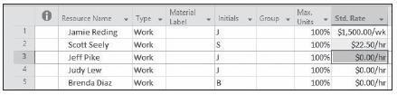
Step-by-Step: Enter Resource Cost Information
Widen the Std. Rate column by moving the mouse pointer to the vertical divider line between the Std. Rate column and Ovt. Rate column. Double‐click on the divider line. This is called Auto‐fitting. Your screen should look similar to the figure below.
Notes:
Resource Sheet with the standard rate for first two resources entered

Slide 26
Step-by-Step: Enter Resource Cost Information
Enter the standard pay rates for the remaining resources (see next slide for additional resources/rates to enter):
Resource Name Standard Rate
Jeff Pike 1000/w
Judy Lew 29.50/h
Brenda Diaz 19.75/h
Brad Sutton 16.50/h
Annette Hill 20.00/h
Ryan Ihrig 16.00/h
Yan Li 28.50/h
Model technician 16.50/h

Slide 27
Step-by-Step: Enter Resource Cost Information
Continue entering the standard pay rates for the remaining resources:
Resource Name Standard Rate
Digital camera 300/w
Anemometer 20/w
Safety tether 5/w
Clipboards 0
Large Conference Room 0
Small Conference Room 0
SD Card 12
Printer Paper 4
Notes:
Take Note: Notice that you didn’t enter a rate (weekly, hourly, or daily) for the cost of the SD card or the paper. For a material resource, the standard rate is per unit of consumption. For this exercise, that is a 4 GB SD card. Also note that you did not assign a cost to the cost resources; this is done when the cost resources are assigned to a task (covered in Lesson 3).

Slide 28
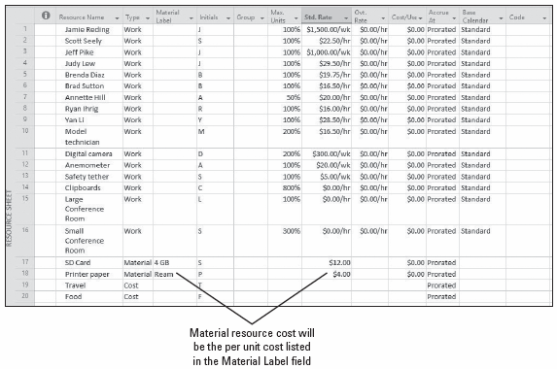
Step-by-Step: Enter Resource Cost Information
Your screen should look similar to the figure below.
SAVE the project schedule.
PAUSE. LEAVE the project schedule open for the next exercise.
Notes:
Standard rates for all work and material resources added to the Resource Sheet

Slide 29
Adjusting Resource Working Times
Microsoft Project 2016 uses resource working and nonworking times to schedule the tasks. You should define these times prior to assigning them to tasks.
Resource working times apply only to people and equipment (work) resources—not to material resources.
When you establish work resources in your project schedule, a resource calendar is automatically created for each resource to define the resource’s working and nonworking time.
The resource calendar provides default working times for an entire project for a particular resource. Typically, you will need to make changes to the individual resource calendars to reflect vacation, flex‐time work schedules, or conference attendance.
Notes:
Now that you have entered resources and their associated pay rates in your project schedule, you can specify the working and nonworking times for some of these resources. In the following exercise, you will establish nonworking times for your individual work resources.

Slide 30
Step-by-Step: Establish Nonworking Times for an Individual Work Resource
GET READY. USE the Tailspin Remote Drone 2 project schedule you saved in the previous exercise.
Click the Project tab and then click Change Working Time. The Change Working Time dialog box appears.
In the For Calendar box, select Jamie Reding. Jamie Reding’s resource calendar appears in the Change Working Time dialog box.
Slide the button next to the calendar until the calendar is on January 2019.
Select the dates January 14 and 15.
In the first Name field on the Exceptions tab, key Vacation Days.
Notes:
Take Note: Keep in mind that when you make changes to the project calendar, the changes are reflected in all resource calendars that are based on the project calendar. However, changes you make to the working times of an individual resource are not reflected in the project calendar. Refer to Lesson 1 for a quick refresher on the types of calendars used by Microsoft Project.

Slide 31
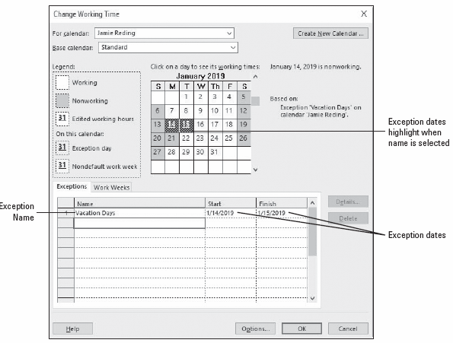
Step-by-Step: Establish Nonworking Times for an Individual Work Resource
Press Enter. Your screen should look similar to the figure shown here.
Click OK to close the Change Working Time dialog box.
SAVE the project schedule.
PAUSE. LEAVE the project schedule open for the next exercise.
Notes:
Notice that the Start field displays 1/14/2019 and the Finish field displays 1/15/2019. Microsoft Project will not schedule Jamie Reding to work on these two days.

Slide 32
Establishing Specific Work Schedules
In addition to specifying exception times for resources, you can set up a specific work schedule for any given resource.
If you need to edit several resource calendars in the same way (to handle a flex‐time schedule or night shift, for example), you might find it easier to assign a different base calendar to this group of resources.
A base calendar can be used as a task calendar, a project calendar, or a resource calendar and specifies default working and nonworking times.
Assigning a different base calendar is quicker than editing each individual resource calendar and it allows you to make future project‐wide changes to a single base calendar (rather than editing each resource calendar again).
Notes:
Take Note: You can also change a resource’s base calendar in the Resource Sheet view by clicking the arrow in the Base Calendar field of that resource.

Slide 33
Establishing Specific Work Schedules
You can change a resource’s base calendar by opening the Change Working Time dialog box from the Tools menu. In the For Calendar box, select the desired resource and then in the Base Calendar box, select the desired base calendar.
For a group of resources that will be using the same calendar, you can change the calendar directly in the Base Calendar column of the Entry table in the Resource Sheet view.
Microsoft Project includes three base calendars: Standard, 24 Hours, and Night Shift. You can customize these or use them as a basis for your own base calendar.

Slide 34
Step-by-Step: Establish a Specific Work Schedule for a Resource
GET READY. USE the Tailspin Remote Drone 2 project schedule you saved in the previous exercise.
Click the Project ribbon and then click Change Working Time to open the Change Working Time dialog box.
In the For Calendar: box, select Scott Seely.
Click the Work Weeks tab.
Click the Details button. The Details dialog box appears.
In the Select Day(s): box, click and drag to select Monday through Thursday.
Select the Set day(s) to these specific working times radio button.
Notes:
Scott works a schedule commonly called 4–10’s, which means he works 4 days a week, 10 hours per day.

Slide 35
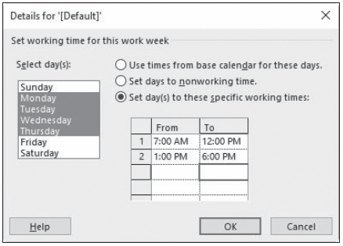
Step-by-Step: Establish a Specific Work Schedule for a Resource
On line 1 of the Working Times box, click the 8:00am box and key 7am.
On line 2 of the Working Times box, click the 5:00pm box and key 6pm.
Press Enter to set your changes. Your screen should look similar to the figure below.
Notes:
Details dialog box showing modified working times for Scott Seely

Slide 36
Step-by-Step: Establish a Specific Work Schedule for a Resource
In the Select Day(s): box, click Friday.
Select the Set days to nonworking time radio button.
Click OK to close the Details dialog box. Microsoft Project can now schedule Scott Seely to work as early as 7:00 a.m. and as late as 6:00 p.m. on Monday through Thursday, but it will not schedule him to work on Friday.
Click on any Friday in the Change Working time dialog box. Note that these days are set to nonworking time.
Click on any one day of the week, Monday–Thursday. Note the working times for these days. Your screen should look similar to the figure on the next slide.

Slide 37
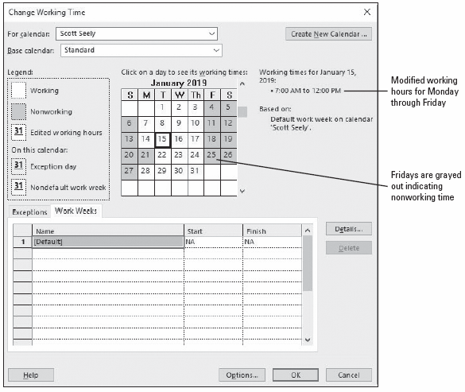
Step-by-Step: Establish a Specific Work Schedule for a Resource
Click OK to close the Change Working Time dialog box.
SAVE the project schedule.
PAUSE. LEAVE the project schedule open to use in the next exercise.
Notes:
Change Working Time dialog box showing the modified resource calendar for Scott Seely

Slide 38
Adding Resource Notes
At times, you might want to provide the details regarding how (and why) a resource is scheduled a certain way.
You can add this additional information about a resource by attaching a resource note.
In the following exercise, you will learn how to attach a scheduling note to a resource in Project 2016.

Slide 39
Step-by-Step: Attach a Note to a Resource
GET READY. USE the Tailspin Remote Drone 2 project schedule you saved in the previous exercise. Make sure you are still in the Resource Sheet view of the Tailspin Remote Drone 2 file.
In the Resource Name column, select the name of the resource 1, Jamie Reding.
On the ribbon, click the Resource tab. In the Properties command group, click the Resource Notes button. The Resource Information dialog box appears with the Notes tab visible.
In the Notes box, key Jamie on vacation Jan 14 and 15; available for consult at home if necessary and click OK. A notes indicator appears in the Indicators column.

Slide 40
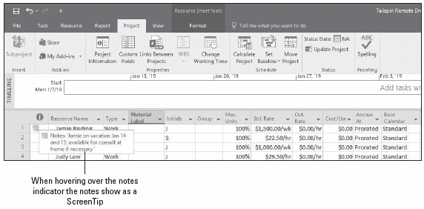
Step-by-Step: Attach a Note to a Resource
Point to the notes indicator in the Resource Sheet. Your screen should look like the figure below.
SAVE and CLOSE the Tailspin Remote Drone 2 file.
Notes:
If you are continuing to the next lesson, keep Microsoft Project open. If you are not continuing to additional lessons, close Microsoft Project.

Slide 41
Skill Summary

